Slide 1
RHCI Data Systems
Julie Hoffer, MPH
August 17, 2021

Slide 2
Presentation Overview
Programs included in data collection
Evolution from early to current data collection
Reporting and quality improvement from program data
Challenges
RHCI keys to success
Q & A

Slide 3
Programs included in data collection
Birth Waiting Homes (2 locations)
Patient Records
Evaluation interviews at discharge
Motorbike Outreach clinics
Under 5’s (sick children and immunizations)
Antenatal care
Family planning
Nutrition
Evaluation interviews at outreach
Patient transports in RHCI vehicles
Patient hospitalizations

Slide 4
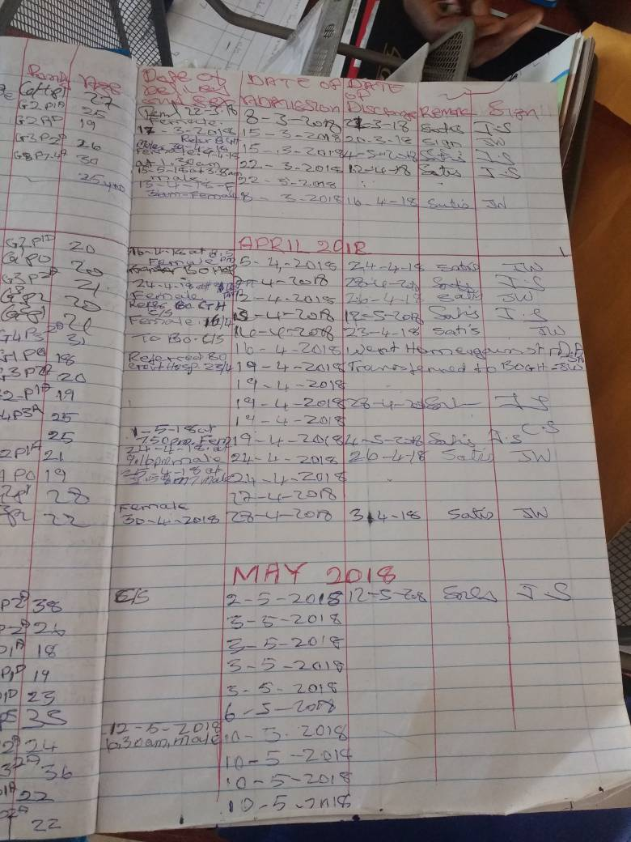
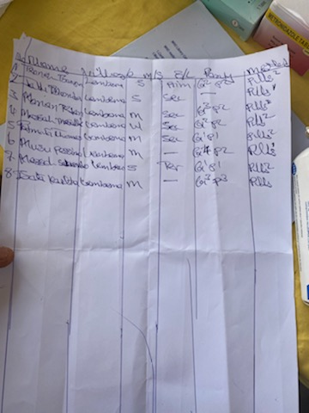
Early data reporting

Slide 5
Data reporting using Excel and laptop computers in-country
NO | Clinic Date | Date of Birth | Child's Name | Location | Weight | Height | MUAC | Z-Score | Oedema | Breastfeeding | New | Follow-up | Malaria Test
1 | 1/7/2021 | 2yrs 7month | M Kamara | Gelehun | 55 | 75 | 14 |  |  |  |  | X
2 |  | 3month | A Kamara | Gelehun | 75 | 67 | 14 |  |  | X |  | X
3 |  | 2yrs 7month | K Muybeh | Gelehun | 15.5 | 91 | 16 |  |  |  |  | X | X
4 |  | 1month | M Kabba | Gelehun | 6 | 59 | 14 |  |  | X |  | X
5 |  | 2yrs | S Mugbeh | Gelehun | 20 | 100 | 15.2 |  |  |  |  | X | X
6 |  | 11month | M Konneh | Gelehun | 7.5 | 67 | 13 |  |  | X |  | X
7 |  | 7month | B Williams | Gelehun | 7.7 | 69 | 14 |  |  | X |  | X
8 |  | 2yrs 10 month | J Massaquoi | Gelehun | 16 | 92 | 15 |  |  |  |  | X | X
9 |  | 1yr | S Katta | Gelehun | 9 | 69 | 15 |  |  | X |  | X
10 |  | 3yrs 7month | M Sesay | Gelehun | 1.6 | 99 | 18 |  |  |  |  | X | X
11 |  | 3month | F Conteh | Gelehun | 5.7 | 55 |  |  |  | X |  | X
Notes:
Laptop computers provided to the in-country director and 4 program managers. Each program manager is responsible for sending their monthly data to me by the 10th of each month. One key staff member who is computer and tech savy to help others in-country.

Slide 6
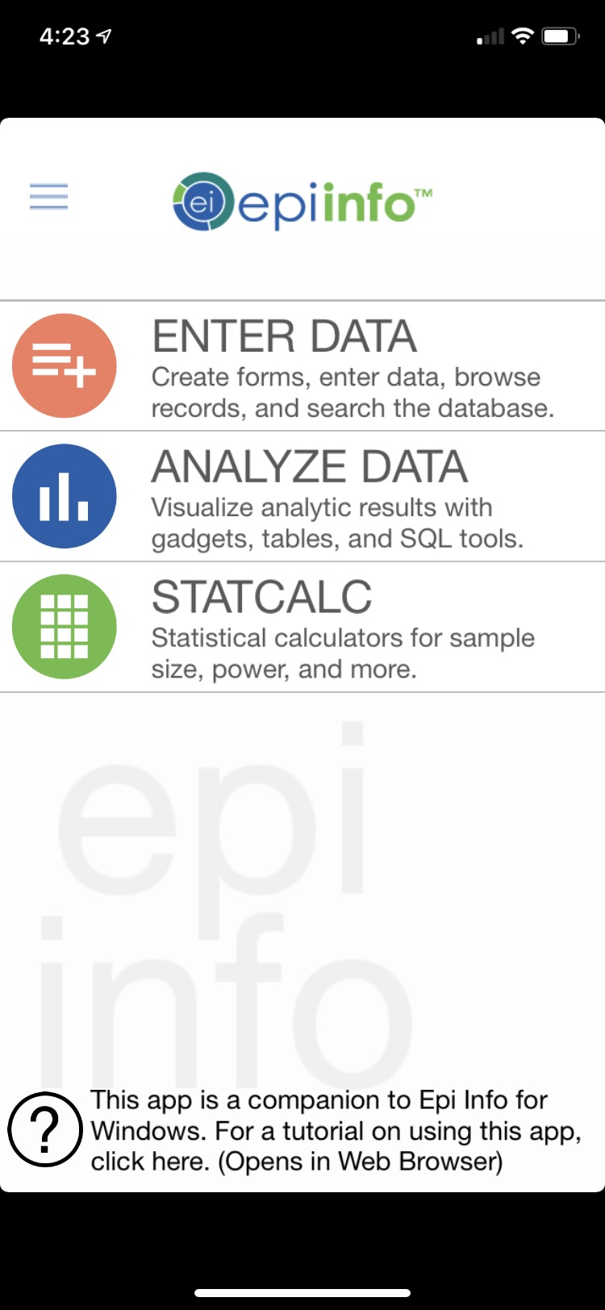
Data using Epi Info
Notes:
Data base is designed and managed here, phone app or iPad collects data in-country and then transmitted via internet to US. No internet is needed when collecting data

Slide 7
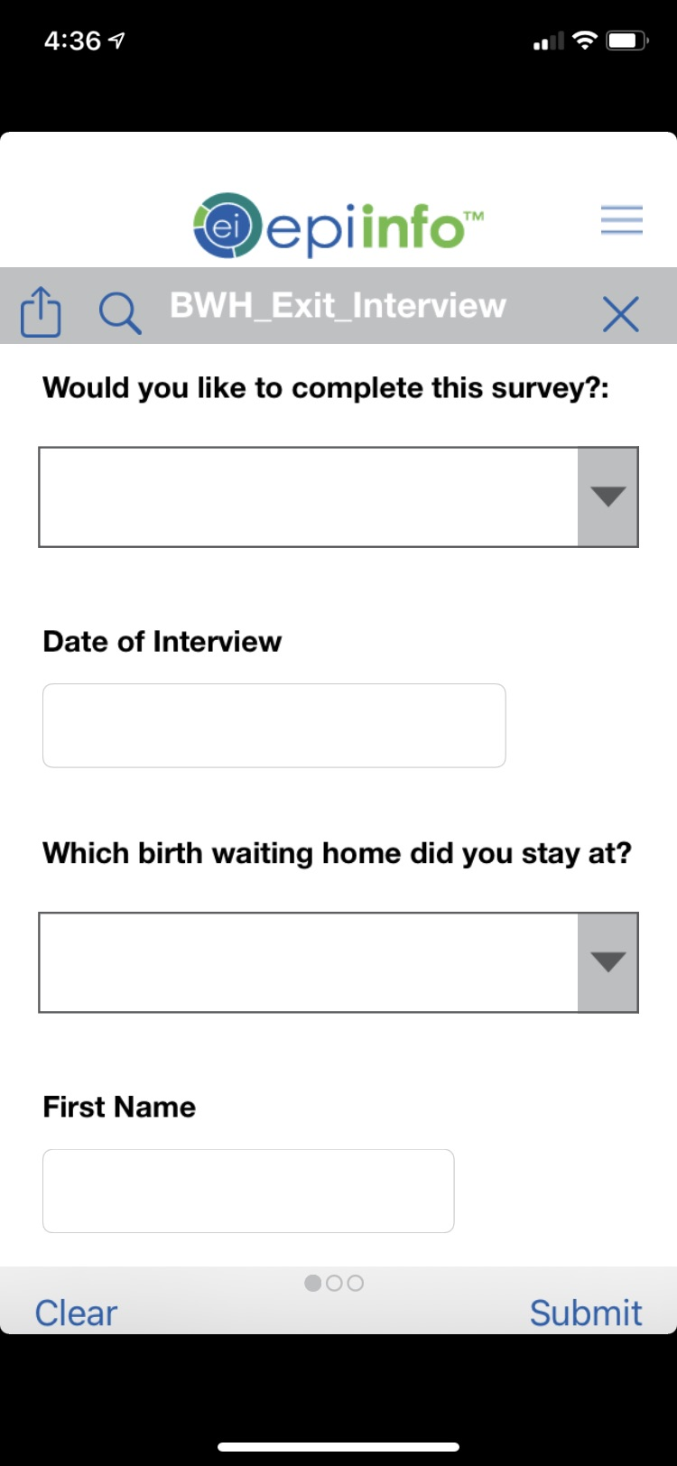
Patient data collection tool in Epi Info

Slide 8
Reporting from program data
U.S. Based Reports
Communications
Fundraising
Annual report
Quarterly Board reports
Annual review of programs (BWH’s)
Some graduate student projects
In-country
Monthly activity report for the DMO

Slide 9
Quality Improvement from Program Data
Background: Catchment area is under-resourced, systems of care and supply chains are broken, access to care is difficult geographically and cultural barriers exist for accessing care. Staff training opportunities are abundant with timely data. This can result in significant improvements to the health of the people we serve.

Slide 10
QI Example 1: Malaria Medication and Test Kits
Data showed repeated motorbike outreach clinics where no malaria tests were performed and no diagnoses of malaria occurred in children or pregnant woman.
In-country staff was consulted to get explanations for low or non-existent malaria diagnoses. Reply: No government supply of test kits or medications.
Supply locked in Bo and no one had a key, responsible person was unavailable
Bo district medical office did not have supplies to distribute
We always run out of medication and test kits. Accepted practice!
Solution: RHCI purchased a supply of test kits and medications. Outreach staff coordinated with CHC one day prior to outreach. RHCI supplies were used if CHC did not have adequate supplies.
THIS TOOK SEVERAL MONTHS TO FULLY IMPLEMENT: In-country staff now responds “We don’t make mistakes regarding malaria treatment, we understand the importance”.

Slide 11
QI Example 2: Referral from RHCI Under 5’s clinic to Nutrition Program
Data showed children treated at the RHCI motorbike outreach clinics that met criteria for evaluation by our nutritionist were not getting referred while they were at outreach.
Staff was consulted and responded that all children were assessed and referred as appropriate.
List of children that were missed referrals were provided monthly.
Solution: CHC staff working outreach were trained in referring children. Outreach coordinators took responsibility for improving referrals. RHCI nutritionist visited missed children in their home village for an initial assessment and treatment.
THIS IS STILL IN PROGRESS

Slide 12
Example 3: Review of Child Deaths in the Nutrition Program
Data showed three children participating in the RHCI nutrition program died due to severe acute malnutrition. This outcome was devastating to the RHCI in-country staff and program advisors in the U.S.
Barriers were found when hospital referral was recommended regardless of RHCI covering costs for hospitalization, transportation and a small stiped for the caregiver to purchase food while they cared for their hospitalized child.
Solution: Increased education to caregivers of children in the nutrition program. Improved RHCI protocols to identify SAM children and refer them quickly for hospital care. Empowered RHCI staff to be assertive in sending any child that met any of the protocol criteria for hospitalization to refer.

Slide 13
Challenges
Communication
Technology
Internet reliability
Education of in-country staff

Slide 14
Keys to Success
In-country data and technology champion, Joseph Sogbandi
Patience and dedication state-side
Cheerleading for our in-country team
TIME
State-side skills to design surveillance systems and tools
Organization support: finances, technical skills

